Slide 1
Alignments: Purpose, Assessment and Application
Jill Pecon Slattery, Ph.D.
slatteryjp@si.edu
www.cornerstonegenomics.com

Slide 2
Introduction
Purpose
Alignments are an essential, critical step before proceeding to population genetic or phylogenetic analyses with mitochondrial, plastid, or genomic sequence data
What is an Alignment?
An alignment is a multiple sequence file of either nucleotide or amino acid residue data from a particular genomic region.
The alignment estimates identity by decent for each site within the sequence.
What Type of Data?
Nucleotide or protein sequence.
Type of Application?
Primer Design
Genome Mining Homology Searches for Marker Development
Population Structure and Phylogeography of a Species
Patterns of Speciation
Evolution of Gene Families
Identification of Gene Structure, Function and Evolution
Whole Genome Structure and Evolution
Interpretation of functional variants & ‘omics’: Transcriptome, proteome, resistome, metabolome, etc
Why Are Alignments So Important?

Slide 3
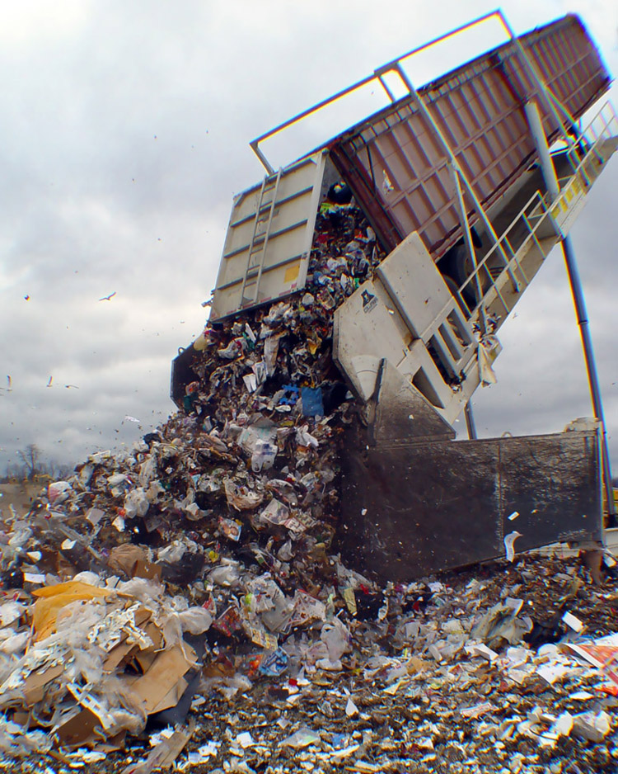
“Garbage IN - Garbage OUT”

Slide 4
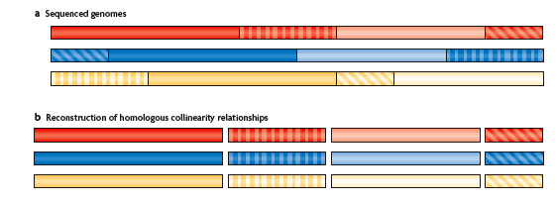
COMPARATIVE GENOME SEQUENCING AND ALIGNMENT
MARGULIES AND BIRNEY NAT REV 2008

Slide 5
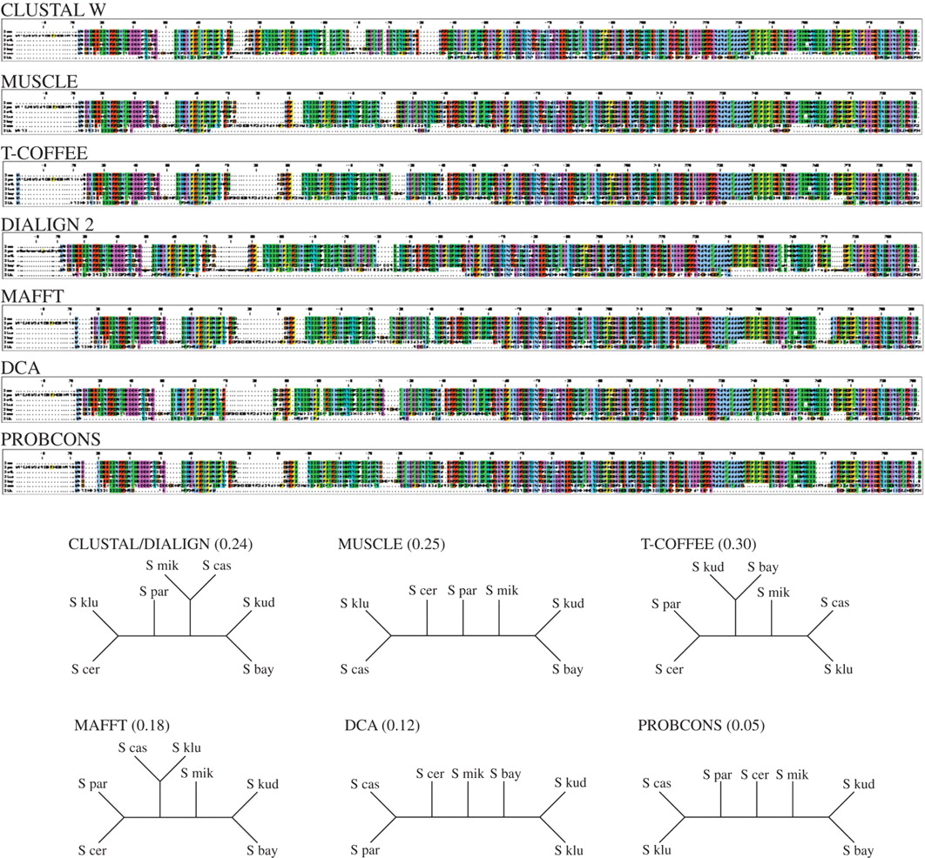

Fig. 1. An example, involving ORF YPL077C, in which alignments produced by seven different alignment methods produce six different estimated trees, albeit with low bootstrap support (bootstrap proportions shown parenthetically for each tree).
Karen M. Wong et al. Science 2008;319:473-476
Published by AAAS

Slide 6
Steps in Alignment Construction

Slide 7
The Alignment Process Features-Progressive Alignment
Sub-segments (local alignment)
Fragment of sequence
Searching data base
BLAST
Global Alignment
Entire sequence considered
Phylogenetics
Comparative Genomics

Slide 8
Minimizing the Differences
What does it take to convert one sequence into another?
Computation of Cost
Mismatch
Gaps
 | - | A | G | T | A
- | 0 | 0 | 0 | 0 | 0
A | 0 | 0 | 1 | 1 | 0
C | 0 | 1 | 1 | 1 | 1
C | 0 | 1 | 1 | 1 | 1
T | 0 | 1 | 1 | 0 | 1

Slide 9
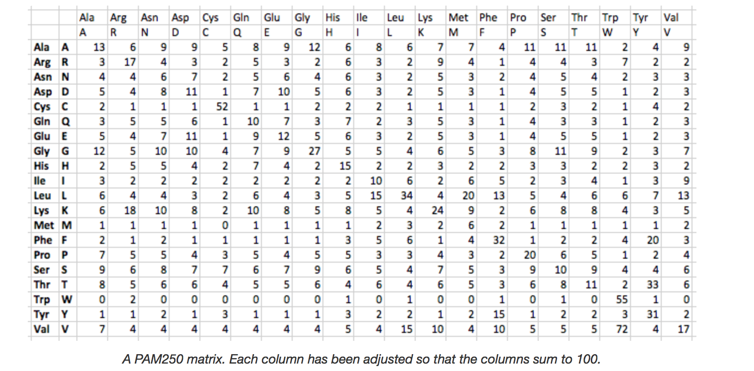
Cost for Mutation: Amino Acid Residues
How to estimate probability of one amino acid mutating into another.
Empirical Data Models
Models such as PAM-HOFF, JTT, WAG commonly used for nuclear proteins.
Organelle specific matrices:
MtREV
cpREV10, cpREV64
Pathogens
FLU Influenza
New advances are developing approaches that are scalable to deal with excessively large scale studies of protein families
Assumptions in constructing alignment minimize cost to preserve physical and chemical properties
New algorithms are benchmarked against databases such as BAliBase composed reference data aligned with 3D structure.
Notes:
Hence, various empirical amino acid substitution rate matrices have needed to be estimated for phylogenetic analysis: JTT, WAG, and LG for nuclear proteins, mtREV for mitochondrial proteins, cpREV10 and cpREV64 for chloroplast-encoded proteins, and FLU for influenza proteins. This assumes that each site evolves independent of each other, which we know if not true for protein function.
Based on empirical analyses of protein sequences. Changed over the years to generate matrices related to organelle nuclear
The efficiency of MSA programs can benchmarked, resulting in useful guidelines. In order to assess and compare the efficiency of the nine programs listed above, the BAliBASE benchmark dataset was selected [16]. BAliBASE was the first large scale benchmark specifically designed for MSA, providing high quality manually refined reference alignments based on 3D structural superpositions. The benchmark presents challenging test cases simulating real problems faced when aligning multiple sequences, which are divided into different datasets. The current version of the BAliBASE is divided into several reference datasets. The first five contain: Reference 1- cases with small numbers of equidistant sequences, and was further subdivided by percent identity; Reference 2- families with one or more “orphan” sequences; Reference 3- a pair of divergent subfamilies, with less than 25% identity between the two groups; Reference 4- sequences with large terminal extensions (N/C-terminal); and Reference 5- sequences with large internal insertions and deletions. For References 1 to 3 and 5, full-length sequences were provided in addition to the sequences with homologous regions only, to test the performance of MSA methods in the presence of “noise” in the form of non-conserved extensions. The next three reference alignments, 6, 7 and 8, contain sequences with repeats, transmembrane regions, and inverted domains, respectively. Reference 6 contains subsets with repeats having different residue similarity and input order and with the presence of additional domains. Reference 7 includes sequences with predicted transmembrane regions divided into subgroups with highly conserved core blocks. Reference 8 have sequences with two different domains in which their order is not preserved [17]. The most recent dataset added to BAliBASE is Reference 9 [18], which includes protein families with linear motifs often found in disordered regions that are difficult to align.

Slide 10
Multiple Alignment
Problem: True simultaneous alignment would be multi-dimensional and prohibitively computer intensive
Strategy:
Series of pairwise alignments combined into multiple alignments.
Guide trees constructed for intermediate levels of addition and tested.
Different alignment programs use different ways of creating the final multiple sequence file using both global and local methods
Traditional approach uses a progressive alignment based on evolutionary relationships of sequences
Iterative alignment methods (MCMC) that also include biological features to help align ( e.g. circular genomes)
Notes:
Traditionally the most popular approach has been the
progressive alignment procedure [14], which exploits the fact that
homologous sequences are evolutionarily related. A multiple
sequence alignment is built up gradually using a series of pairwise
alignments, following the branching order in a phylogenetic tree.
A number of different alignment programs based on this method
have been developed, includingboth global and local approaches.
A global MSA algorithm is defined here as one that tries to align
the full length sequences from one end to the other. Once the
global alignment has been constructed, other methods are often
used to identify the more conserved or reliable regions within the
alignment. A local algorithm attempts to identify subsequences
sharing high similarity.

Slide 11
Verification of Alignment
Critical Assessment
A priori knowledge about marker can help but is not essential
“ by eye”
Check insertion/deletions
Notorious problem motifs for alignment programs
Check divergent sequences
“Stochastic” alignment if sequences are too divergent
Check if known structures ignored
Protein or RNA secondary structures

Slide 12
Phylogenetic Consequences of Alignment: Nucleotide Data

Slide 13
Alignments 1: Transition:Transversion Bias
Nucleotides: A C G T
Adenine and Guanine (Purines)
Thymine and Cytosine (Pyrimidines)
A
C
T
G

Slide 14
Alignments 2: Among Site Rate Variation

Slide 15
Alignments 3: Nucleotide Frequency Bias
EMPIRICAL FREQUENCY
A C G T
GENOMIC REGION
ZFY INTRON 30.6 13.6 17.6 38.2
ZFY EXON 32.3 22.6 22.1 23.0
LENTIVIRUS POL GENE 42.4 12.8 19.8 24.9
LENTIVIRUS LTR 28.9 18.8 23.4 28.7

Slide 16
Alignment 4: Coding Regions
Codon Triplet: 1st, 2nd, 3rd Positions
Synonymous (dS) and Nonsynonymous (dN) Substitutions
Non-degenerate (2nd position): all encode nonsynonymous (amino acid altering) substitutions
Two-fold degenerate (1st position): both nonsynonymous and synonymous substitutions
Four-fold (3rd position): all synonymous
Selection
Non-neutral marker
dN/dS = ω
ω   Neutral evolution
ω < 1 Purifying selection to maintain function
ω   Positive selection for adaptation
Translation into amino acid residues to aid alignment
Ancient divergence events
Rapidly mutating genomes
Detection of selection in candidate marker
Identification of conserved motifs

Slide 17
Alignment 5: Recombination
Forms of Recombination During Chromosomal Pairing (Eukaryotes)
Conventional reciprocal exchange
Allelic between sister chromatids
Gene conversion (nonreciprocal exchange)
Donor and recipient
Allelic (between sister chromatids)
Non-allelic (between paralogous regions)
Forms of Recombination (Pathogens)/Horizontal gene transfer
Viruses (replication cycle in cells multiply infected with different strains)
Bacteria (transformation, transduction, conjugation)
Detection of Recombination in the Alignment (Host & Pathogens)
Motif: Stretch of contiguous sites within alignment
Programs to detect recombination motifs
RDP4, Martin et al 2015 (http://web.cbio.uct.ac.za/~darren/rdp.html)
List of other recombination detection programs
http://bioinf.man.ac.uk/robertson/recombination/programs.shtml
Phylogenetic approach with multiple sequences
Analyses of genes, partitioned chromosome region
Notes:
Viruses are in a perpetual arm race with their hosts. Camouflage is a common strategy viruses use to escape to the immune system (either innate or adaptive) of their hosts. This generally translates in a propensity to develop replication strategies that are, at different extents, prone to the insertion of mutations in their genome. Accumulation of mutations is nevertheless limited by the need to maintain viability and its own genetic identity. Keeping the subtle equilibrium between these two contrasting forces is vital for viruses, it often influences their pathogenic potential, and can be at the origin of outbreaks of infection of relevance for public health.
Recombination is an important source of genetic variability in viruses, particularly for viruses possessing an RNA genome. The remarkable power of recombination resides in its ability, in a single infectious cycle, to generate new combinations of mutations. This is important at two regards: one is that recombination does not generate new mutations but reshuffles pre-existing ones, whose compatibility with viral survival has already been established. This is expected to increase the probability of having a viable recombinant progeny. On the other hand, the fact that, in general, several mutations are simultaneously introduced through the recombination process, is expected to favour the opposite outcome: that a high proportion of recombinant products will not be viable. Finally, recombination in concert with natural selection, can be responsible of combining advantageous mutations, as well as removing deleterious ones, by far the most abundant type of mutations found in nature.

Slide 18
Alignment 6: Insertion/Deletions
SIV/HIV alignment gp120: Hypervariable regions with excessive rates of insertion/deletion
Clustal Omega
PRANK+F
Phylogeny-Aware Gap Placement Prevents Errors in Sequence Alignment and Evolutionary Analysis Ari Löytynoja, et al. Science 320, 1632 (2008)
Notes:
Fig. 1. Different sequence alignment approaches can give contradicting pictures of evolutionary mechanisms behind functional sequence changes. (A) (top) The CLUSTAL W (12) alignment of gp120 from different strains of human and simian immunodeficiency virus (5) represents a typical structural matching of protein sequences and clusters nearby alignment gaps in tight blocks. (bottom) The expanded fragment suggests that part of the V2 region evolves with a high rate of point substitutions and is shortened over evolutionary time by numerous overlapping deletions. For example, the pattern of gaps highlighted with a green box requires eight independent deletions, which have occurred in the lineages marked with green dots in the tree on the left. (B) (top) The PRANK+F (5) alignment of
the same sequences suggests a markedly different evolutionary process dominated by short insertions and deletions. This phylogeny-aware algo- rithm separates distinct insertions that have taken place at the same positions (bottom: examples highlighted with blue and red boxes and dots) while permitting homologous sites to be deleted multiple times when the data support this (e.g., column highlighted in green). Alignment annotations indicate the V1 to V5 variable regions, C108g epitope, CD4- binding loop, N-linked glycosylation sites (residues N in bold white type), and a helices (blue blocks) and b strands (red blocks) of the known HIV-1 gp120 structure (5). Both alignments used the guide phylogeny generated by CLUSTAL W (left).

Slide 19
Recombinant Strain in Canine Distemper Virus
Yuan C, Liu W, Wang Y, Hou J, Zhang L, Wang G (2017) Homologous recombination is a force in the evolution of canine distemper virus. PLoS ONE 12(4): e0175416

Slide 20
ALIGNMENT 7: RETROELEMENTS IN SEQUENCE
EXAMPLES FROM MAMMALIAN GENOME
Nomenclature Replication Example Copy Signature Number
Endogenous retrovirus LTR, RT, env enFeLV, HERV 10-10²
Retrotransposon LTR, RT HERV-H 10²-10⁴
Retroposon RT, int. promotor LINEs 10⁴ - 10⁵
Solitary LTR LTR 10-10⁴
SINEs Int. promotor Alu, CAN-SINES 10⁵-10⁶
Processed
Pseudogenes Cellular Promotor Ribosomal genes ~10⁴
Notes:
The processed pseudogenes reported to date fall into three categories: those that are a complete copy of the mRNA transcribed from the functional gene, those that are only a partial copy of the corresponding mRNA, and those that contain sequences in addition to those expected to be present in the mRNA
made from mRNA retrotransposition.

Slide 21
SINE Retroelements in Felidae

Slide 22
Rare Excision of SINE element in Puma Genome

Slide 23
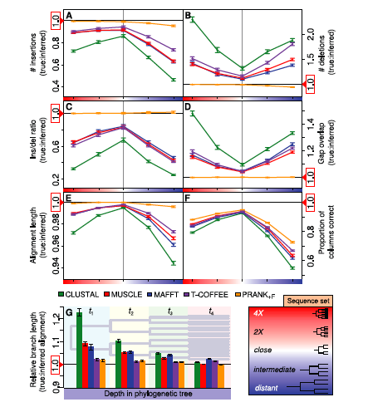
Which Alignment Is Best?
Loytynoja and Goldman
Science 2008

Slide 24
Translation Alignment
Translates nucleotide files into amino acids
Aligns amino acids
Translates back to original nucleotides using the scaffold of amino acid alignment.
Beware: For highly divergent sequences, still must edit by eye
Example: TRANSLATER X, REVTRANS

Slide 25
Statistical Alignment
Important for full genome comparisons in whole genome sequencing projects where verification by eye not feasible.
Created to deal with ambiguities within alignment.
Jointly estimates alignment and phylogeny without potential bias of guide tree used in progessive alignments.
All possible alignments are considered
Bayesian framework to assess confidence using posterior probabilities
Recent 2017 study by Bugusz & Whelan (Syst. Biol) indicates performances differ over divergence time.
Notes:
Syst Biol (2017) 66 (2): 218-231

Slide 26
Statistical Alignment Programs
BAli-Phy: Bayesian Alignment and Phylogeny Estimation
BEAST: Bayesian Evolutionary Analysis Sampling Trees
Alifritz: Simultaneous Statistical Multiple Alignment and Phylogeny Reconstruction
DART: DNA, Amino and RNA Tests
StatAlign
PRANK: Probabilistic Alignment Kit
PaHMM-Tree
Notes:
An alternative approach to alignment is to describe
sequence change in an “evolutionarily aware” context,
where the processes of insertion, substitution, and deletion
are modeled explicitly on a phylogenetic tree. This approach,
known as statistical alignment (Thorne et al. 1992; Hein et al.
2000), is appealing because it approximates what happens
during sequence evolution. Computational limitations
mean statistical alignment is rarely used in practice, but the
ongoing development of modern implementations, such as
BAli-Phy (Redelings and Suchard 2005) and StatAlign (Novak
et al. 2008), may help alleviate these computational concerns.
Recently, the program Prank (Lo¨ytynoja and Goldman 2008)
has been developed, which also takes an evolutionary
approach to alignment and may be considered a heuristic
to full statistical alignment.

Slide 27
Scaling to accommodate excessively large datasets:
50,000-100,000 sequences
Programs such as PASTA, SATe-II, PHMM-Tree
Develop computational shortcuts
‘Evolutionary Aware’ constructing ‘correct’ Alignment and Tree Simultaneously

Slide 28
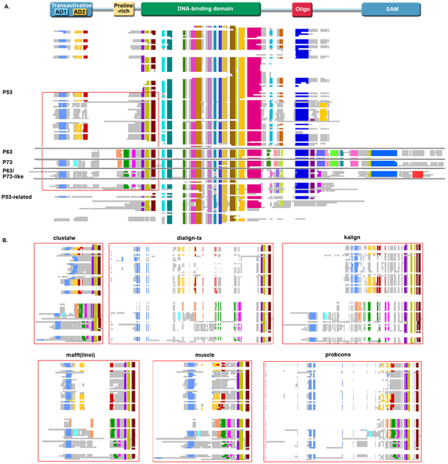

Figure 1. An example benchmark alignment.
Thompson JD, Linard B, Lecompte O, Poch O (2011) A Comprehensive Benchmark Study of Multiple Sequence Alignment Methods: Current Challenges and Future Perspectives. PLOS ONE 6(3): e18093. https://doi.org/10.1371/journal.pone.0018093
http://journals.plos.org/plosone/article?id=10.1371/journal.pone.0018093

Slide 29
Post-Genomic Era: Issues in MSA Algorithms & Benchmarking
Scalability to accommodate large numbers of sequence of genomes
Unequal representation of taxa in genome databases (traditional model organisms)
Increased complexity of protein data & homology: multi-domains, large natively disordered regions, splicing transcripts unique to each new organism added to databases. While alignment programs might preferentially remove these regions, ignore vital functions of important motifs (signalling, post-translational modifications.
Pipeline programs designed to automatically predict new genes error prone (accuracy <50%)
Next gen sequencing producing flood of short reads not properly filtered—noisy data clogging up genome datasets
Notes:
Although the current flood of data clearly
provides unique opportunities for systems-level studies, it also
poses many new challenges, in addition to the obvious scalability
issues. First, although the range of organisms studied has increased
recently, a relatively small number of model organisms still
dominate the public databases. Second, the protein families
represented in today’s sequence databases are often more
complex, with multidomain architectures, large unstructured
(natively disordered) regions, numerous splicing variants, etc.
Third, the new sequences are mostly predicted by automatic
methods and thus, contain a significant number of sequence errors
[33,34]. For example, the EGASP assessment of gene prediction
algorithms showed that the best gene prediction systems are able
to predict entirely correct sequences for protein transcripts in the
human genome only 50% of the time [35]. The problem has been
further exacerbated by the next generation (massively parallel)
DNA sequencing instruments that can sequence up to one billion
bases in a single day at low cost [36]. These new technologies
produce read lengths as short as 35–40 nucleotides, resulting in
fragmentary protein sequences that pose problems for bioinformatics
analyses [37].If MSA methodology is tokeep pace with the
new challengespresented by this complex and often ‘noisy’
sequence data, the alignment benchmarks used for evaluation
must now evolve to reflect this changing biological sequence space
Nevertheless, many proteins,
particularly in eukaryotes, are unstructured (natively disordered)
or contain large unstructured regions.These regions frequently
contain motifs, such as signalling sequences or sites of posttranslational
modifications, that are involved in the regulatory functions
of a cell [38,39]. While this complexity alone represents a
significant challenge for today’s MSA algorithms, another major
goal of our study was to investigate the effect of the ‘noisy’ data,
including fragmentary or otherwise erroneous sequences, on MSA
program performance.

Slide 30
MAFFT: Progressive Methods
Method FFT-NS-1, FFT-NS-2 (Simple Progressive: makes a rough distance matrix by counting the number of shared 6-tuples between every sequence pair, (2) build a guide tree and (3) align the sequences according to the branching order.
Commands for FFT-NS-1
mafft --retree 1 input_file > output_file
or
fftns --retree 1 input_file > output_file
Commands for FFT-NS-2 (In FFT-NS-2, the first 3 step are done, then (4) the guide tree is re-computed from the FFT-NS-1 alignment, and (5) the second progressive alignment is carried out)
mafft --retree 2 input_file > output_file
or
fftns input_file > output_file

Slide 31
MAFFT: Iterative refinement method
Commands for FFT-NS-i (max. 1,000 cycles)
mafft --maxiterate 1000 input_file > output_file
or
fftnsi --maxiterate 1000 input_file > output_file
The iterative refinement is repeated until no more improvement in the WSP score is made or the number of cycles reaches 1,000.
Commands for FFT-NS-i (max. 2 cycles)
mafft --maxiterate 1000 input_file > output_file
or
fftnsi input_file > output_file
Notes:
The weighted sum-of-pairs (WSP) score proposed by Gotoh is used.

Slide 32
MAFFT: Extremely Difficult Case 1
E-INS-I for conserved blocks interspersed with hypervariable regions
^{Commands for E-INS-i}
mafft --genafpair --maxiterate 1000 input_file > output_file
^{or}
^{einsi input_file > output_file}
Notes:
In order to obtain more accurate alignments in extremely difficult cases, three new options, L-INS-i, G-INS-i and E-INS-i, have been added to recent versions (v.≥5) of MAFFT. These options use a new objective function combining the WSP score (Gotoh) explained above and the COFFEE-like score (Notredame et al.), which evaluates the consistency between a multiple alignment and pairwise alignments (Katoh et al. 2005).

Slide 33
MAFFT: Extremely Difficult Case 2
L-INS-I for Conserved blocks with unalignable flanks
Commands for L-INS-I
mafft –localpair –maxiterate 1000 input _file>output_file
Or
linsi input_file > output_file
Notes:
In order to obtain more accurate alignments in extremely difficult cases, three new options, L-INS-i, G-INS-i and E-INS-i, have been added to recent versions (v.≥5) of MAFFT. These options use a new objective function combining the WSP score (Gotoh) explained above and the COFFEE-like score (Notredame et al.), which evaluates the consistency between a multiple alignment and pairwise alignments (Katoh et al. 2005).

Slide 34
MAFFT: Extremely Difficult Case 3
G-INS-i for Conserved blocks with unalignable flanks, the flanks are truncated in order to meet a global alignment criteria(Needleman-Wunch
G-INS-i
mafft --globalpair --maxiterate 1000 input_file > output_file
or
ginsi input_file > output_file
Notes:
In order to obtain more accurate alignments in extremely difficult cases, three new options, L-INS-i, G-INS-i and E-INS-i, have been added to recent versions (v.≥5) of MAFFT. These options use a new objective function combining the WSP score (Gotoh) explained above and the COFFEE-like score (Notredame et al.), which evaluates the consistency between a multiple alignment and pairwise alignments (Katoh et al. 2005).

Slide 35
Notes:
Commands are: a, mafft input;
b, mafft ––randomchain ––randomseed seed input;
c–e, mafft-sparsecore.rb -s seed -p p -i input;
f, clustalo
-i input;
g, clustalo ––full -i input;
h, clustalo ––pileup -i input (sequence order randomized);
i, run_upp.py -m amino -B 100 -s input;
j, run_-
upp.py -m amino -s input;
k, mafft ––globalpair ––thread 10 input;
The order of input sequences was randomized in every sequence set.
The results of
“MAFFT — Randomchain” (b) and “MAFFT — Iterative” (c-e) were averaged for 100 and 10 replications, respectively, with different seeds of random numbers.
The results of “UPP” (i, j) were averaged for 10 different runs.
For “Clustal Omega — Randomchain” (h), only the results for the Small and Medium subsets are
shown, because the calculation of the Large subset did not finish while compiling this manuscript.
The CPU time of “MAFFT — G-INS-1” (k) is shown in parentheses
as it ran on different computer systems from the others.

Slide 36
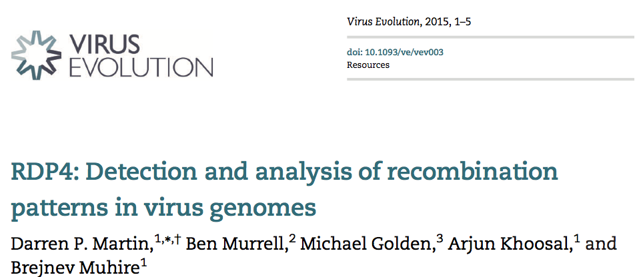
The capacity to differentiate between recombination and genome segment re-assortment
The estimation of recombination breakpoint confidence intervals
A variety of ‘recombination aware’ phylogenetic tree construction and comparison tools
New matrix- based visualization tools for examining both individual recombination events and the overall phylogenetic impacts of multiple recombination events
New tests to detect the influences of gene arrangements, encoded protein structure, nucleic acid secondary structure, nucleotide composition, and nucleotide diversity on recombination breakpoint patterns.
Windows-based but can be installed on MAC OS with PlayOnMac software
http://web.cbio.uct.ac.za/~darren/rdp.html

